Slide 1


INNOVATION. AUTOMATION.ANALYTICS
PROJECT ON
MY SQL

Slide 2

WORLD WIDE ENERGY CONSUMPTION
BY: Mohammed Shoaib khan
Islavath Gowtham
Rohitha Induri

Slide 3


Objective of the Project
The project aims to study energy data from different countries to see how energy is used, how much pollution is created, and how it relates to population and economy.
This helps in finding trends and making better plans for saving energy and protecting the environment.

Slide 4
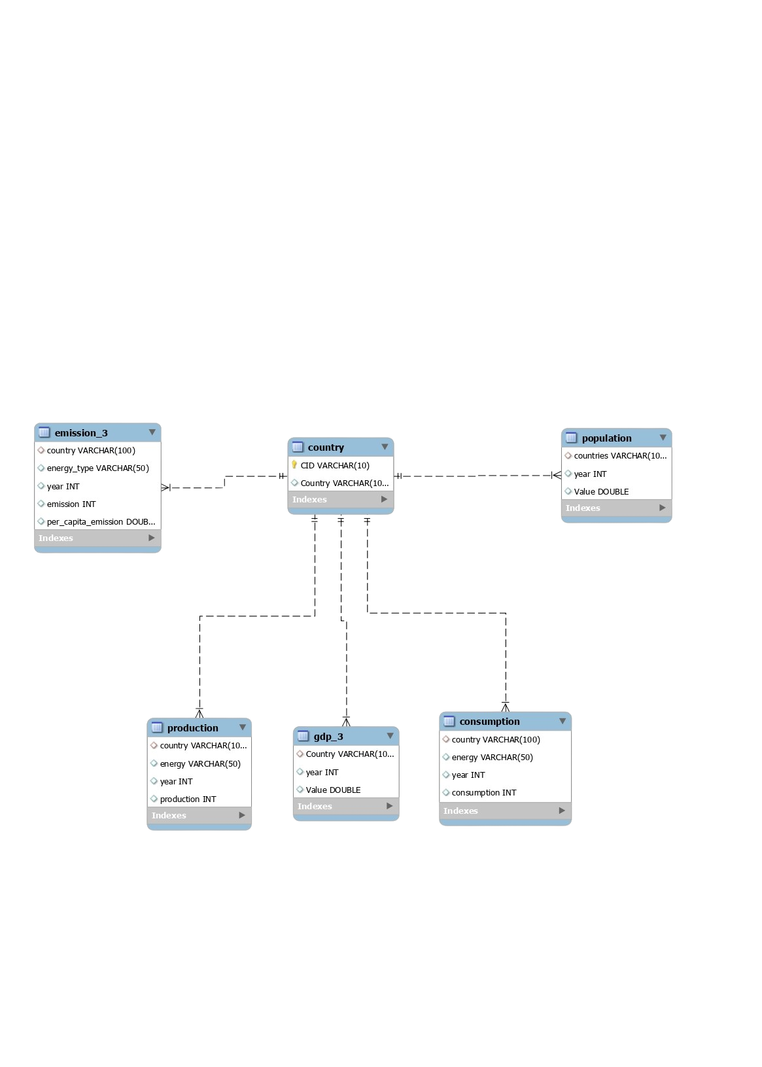

ER Diagram

Slide 5
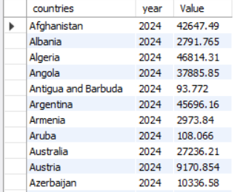
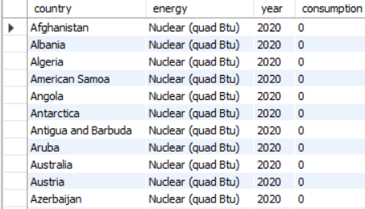
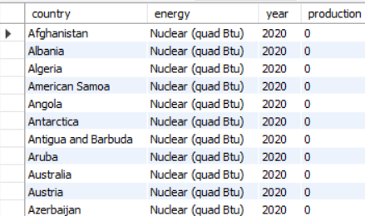
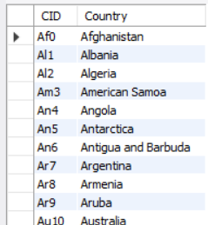
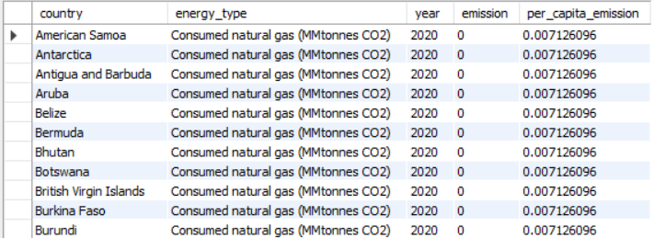
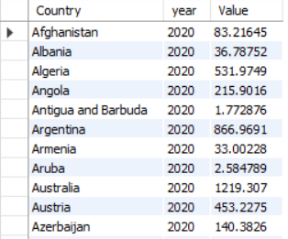
ABOUT TABLE
Population
Consumption
Production
Country(central table)
Per capita emission
GDP

Slide 6

Problem Statement :
Different countries use and produce energy in different ways, which affects pollution and the economy. There was no single system to compare these factors easily.
Our project solves this by creating a MySQL database to study and compare how countries use energy, how much they pollute, and how it connects to population and GDP.

Slide 7

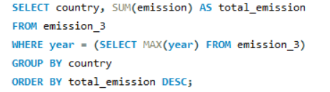
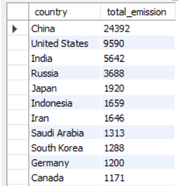
1. What is the total emission per country for the most recent year available?

Slide 8

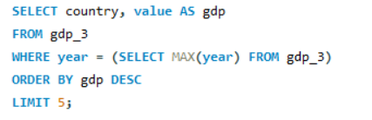
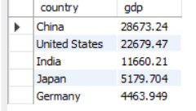
2.What are the top 5 countries by GDP in the most recent year?

Slide 9

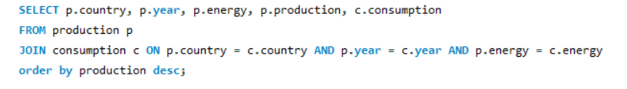
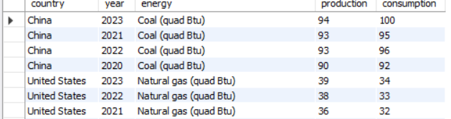
3.Compare energy Products and consumption by Country and Year

Slide 10

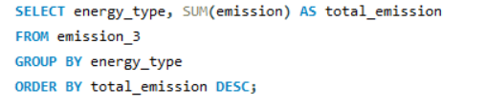
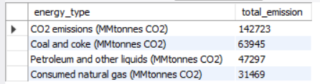
4. Which energy types contribute most to emissions across all countries?

Slide 11

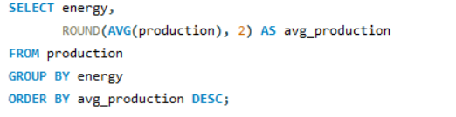
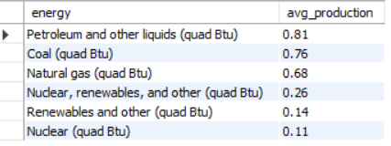
5. What is the average energy production for each energy type across all years?

Slide 12

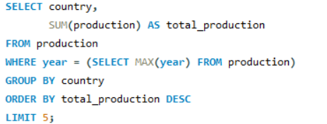
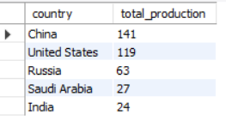
6. Top 5 countries with the highest energy production in the latest year

Slide 13

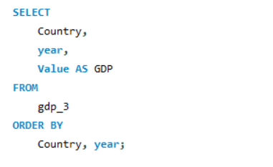
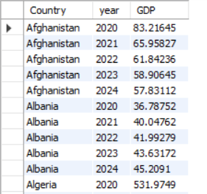
7.What is the trend in GDP for each country over the given years?

Slide 14

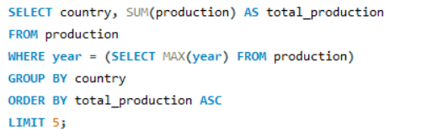
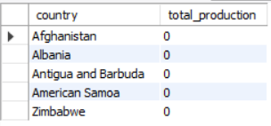
8. Which 5 countries have the lowest total energy production in the latest year?

Slide 15
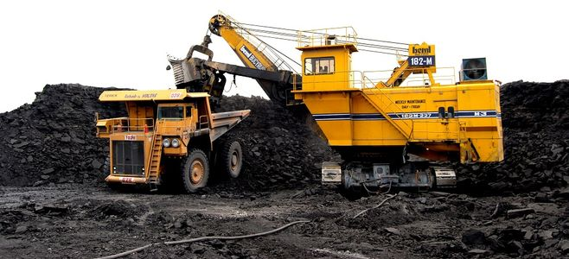
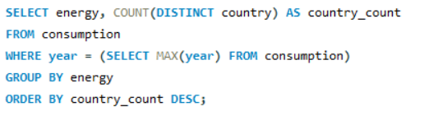
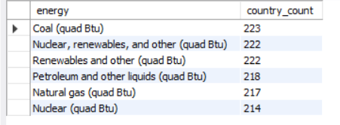
9.Which energy types are used by the most number of countries in the latest year?

Slide 16

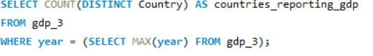

10.How many countries reported GDP data in the latest year?

Slide 17

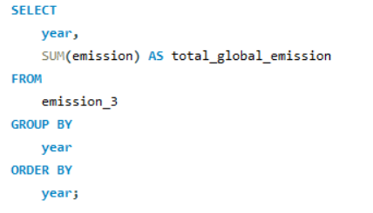
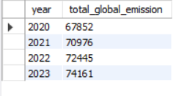
11.How have global emissions changed year over year?

Slide 18

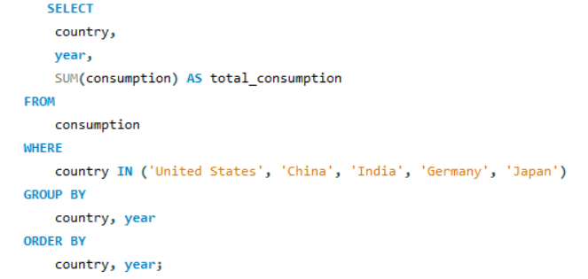
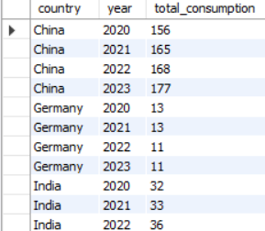
12. Has energy consumption increased or decreased over the years for major economies?

Slide 19

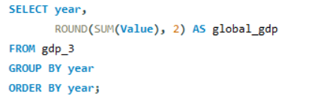
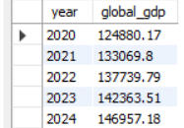
13. What is the global GDP trend over the years?

Slide 20

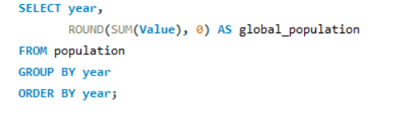
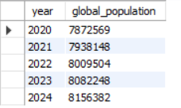
14. How has global population changed over time?

Slide 21

CONCLUSION
1.The project helped me to understand how energy use is linked with
population of economy
2.SQL enabled comprehensive analysis of global datasets.
3. Uncovered valuable insights: top energy users, GDP-emission trends, per capita consumption.

Slide 22

THANK YOU

